Slide 1
Chapter 19
The Baroque in Italy and Spain

Slide 2
Learning Objectives
Understand the characteristics of the Baroque style.
Consider how Baroque religious architecture in Rome reflects the values of the Counter-Reformation.
Investigate the evolution of ceiling painting.
Evaluate the Baroque concept of the “unification” of the arts.
Consider the qualities and innovations of Spanish seventeenth-century art.

Slide 3
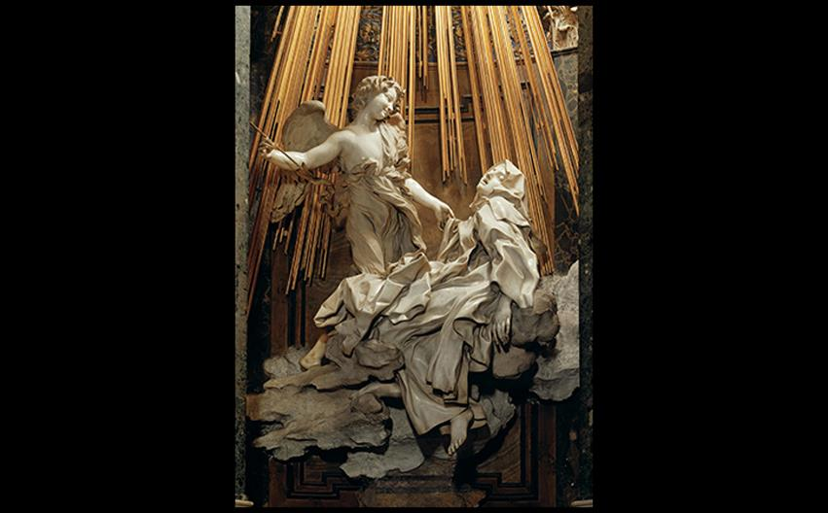
Gianlorenzo Bernini ST. TERESA OF ÁVILA IN ECSTASY Cornaro Chapel, church of Santa Maria della Vittoria, Rome. 1645–1652. Marble, height of the group 11'6" (3.5 m). © 2016. Photo Scala, Florence/Fondo Edifici di Culto – Min. dell'Interno.
Notes:
Gianlorenzo Bernini ST. TERESA OF ÁVILA IN ECSTASY Cornaro Chapel, church of Santa Maria della Vittoria, Rome. 1645–1652. Marble, height of the group 11'6" (3.5 m). © 2016. Photo Scala, Florence/Fondo Edifici di Culto – Min. dell'Interno.

Slide 4
"Baroque" (1 of 2)
As rulers' economic strength slipped away, artists found patrons in the Church and prosperous middle class.
Baroque art was meant to evoke intense emotional responses from viewers.
Many artists sought lifelike depiction in their portraiture, genre paintings, still life, and religious scenes.

Slide 5
"Baroque" (2 of 2)
The role of viewer changed in the time of the seventeenth century.
Masters sought to engage viewers as participants in the artwork, reaching beyond the frame.

Slide 6
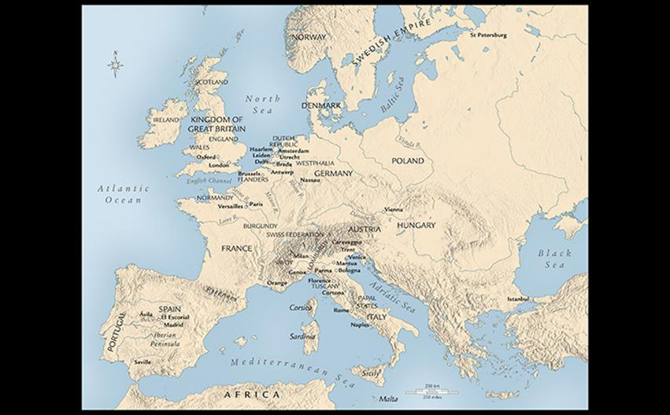
SEVENTEENTH-CENTURY EUROPE Protestantism still dominated northern Europe, while in the south Roman Catholicism remained strong after the Counter-Reformation. The Habsburg empire was now divided into two parts, under separate rulers.
Notes:
SEVENTEENTH-CENTURY EUROPE Protestantism still dominated northern Europe, while in the south Roman Catholicism remained strong after the Counter-Reformation. The Habsburg empire was now divided into two parts, under separate rulers.

Slide 7
Italy
Seventeenth-century Italy remained divided.
Art was used to inspire the revitalization of the Roman Catholic Church.
Guidelines set by the Council of Trent went against the lascivious trends exploited by Mannerism.

Slide 8
Maderno and Bernini at St. Peter's (1 of 3)
The Counter-Reformation sought to embellish the church and its settings properly.
Pope Sixtus ordered open spaces to be cleared in front of major churches in Rome.
Building programs nearly bankrupted the Church.

Slide 9
Maderno and Bernini at St. Peter's (2 of 3)
Bernini supervised the design and building of a colonnade to enclose the double piazza in front of the church, which already contained an Egyptian obelisk and a fountain.
He characterized the design as the "motherly arms of the church."

Slide 10
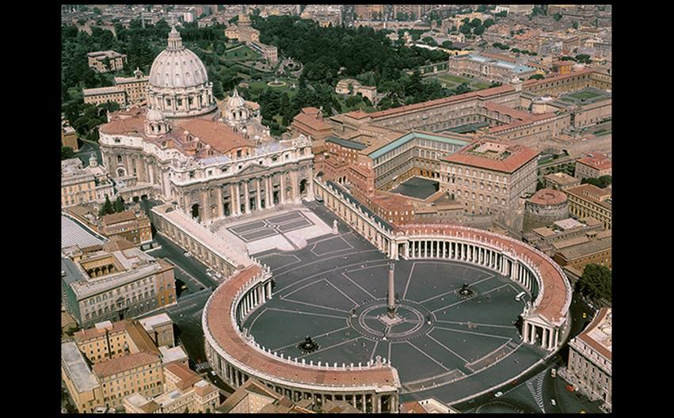
Carlo Maderno and Gianlorenzo Bernini ST. PETER'S BASILICA AND PIAZZA, VATICAN, ROME Maderno, façade, 1607–1626; Bernini, piazza design, c. 1656–1657. © Alinari Archives/Corbis.
Notes:
Carlo Maderno and Gianlorenzo Bernini ST. PETER'S BASILICA AND PIAZZA, VATICAN, ROME Maderno, façade, 1607–1626; Bernini, piazza design, c. 1656–1657. © Alinari Archives/Corbis.

Slide 11
Maderno and Bernini at St. Peter's (3 of 3)
Pope Urban VIII gave Bernini the task of designing the bronze baldacchino (canopy) over the altar of St. Peter's.
He chose a form of winding grapevines to encircle copies of columns from Solomon's Temple in Jerusalem.
Emblems of honeybees, suns, and laurel leaves—signifying the Barbarini family—are also prominent in the design.

Slide 12
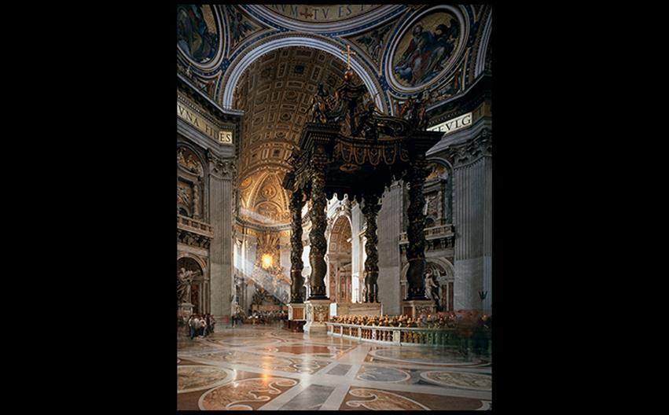
Gianlorenzo Bernini BALDACCHINO St. Peter's Basilica, Vatican, Rome. 1624–1633. Gilt bronze, height approx. 100' (30.48 m). Chair of Peter shrine, 1657–1666; gilt bronze, marble, stucco, and glass. Pier decorations, 1627–1641; gilt bronze and marble. © akg-images/Bildarchiv Monheim.
Notes:
Gianlorenzo Bernini BALDACCHINO St. Peter's Basilica, Vatican, Rome. 1624–1633. Gilt bronze, height approx. 100' (30.48 m). Chair of Peter shrine, 1657–1666; gilt bronze, marble, stucco, and glass. Pier decorations, 1627–1641; gilt bronze and marble. © akg-images/Bildarchiv Monheim.

Slide 13
Bernini as Sculptor (1 of 2)
Bernini's statue of David introduced a new type of three-dimensional composition that interacts with the space around the viewer.

Slide 14
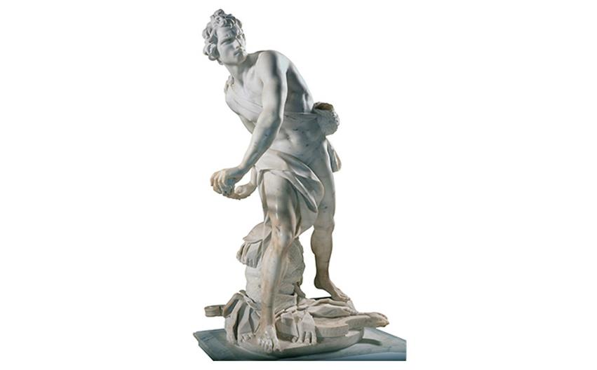
Gianlorenzo Bernini DAVID 1623. Marble, height 5'7" (1.7 m). Galleria Borghese, Rome. © Per concessione del Ministero per i Beni e le Attività Culturali/Archivi Alinari, Firenze.
Notes:
Gianlorenzo Bernini DAVID 1623. Marble, height 5'7" (1.7 m). Galleria Borghese, Rome. © Per concessione del Ministero per i Beni e le Attività Culturali/Archivi Alinari, Firenze.

Slide 15
Bernini as Sculptor (2 of 2)
Bernini was later commissioned to create the sculptural tableau St. Teresa of Ávila in Ecstasy for the funeral chapel of cardinal Federigo Cornaro.
The complex, theatrical interplay dissolves into the painting above.

Slide 16
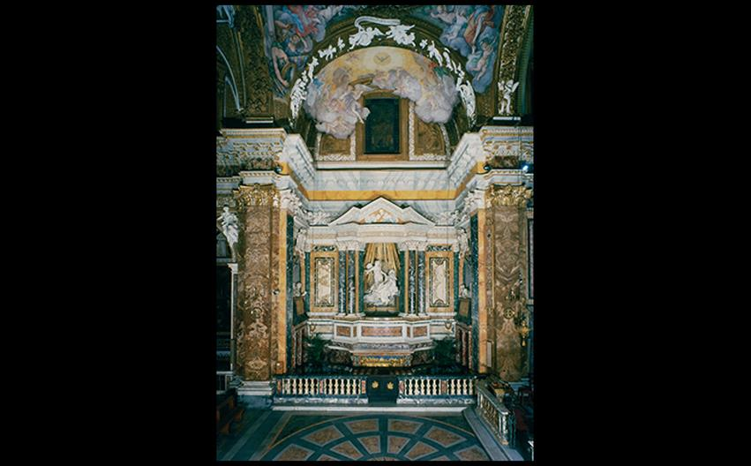
Gianlorenzo Bernini CORNARO CHAPEL, CHURCH OF SANTA MARIA DELLA VITTORIA, ROME 1642–1652. © Vincenzo Pirozzi, Rome.
Notes:
Gianlorenzo Bernini CORNARO CHAPEL, CHURCH OF SANTA MARIA DELLA VITTORIA, ROME 1642–1652. © Vincenzo Pirozzi, Rome.

Slide 17
Borromini (1 of 2)
Church of San Carlo
Francesco Borromini (1599–1667) designed the Church of San Carlo alle Quattro Fontane on an irregular plot at an intersection.
The interior space is marked with an oval dome, a honeycomb of crosses and polygons, and a geometric approach instead of a traditional one.

Slide 18
Borromini (2 of 2)
Church of San Carlo
The façade of the church is filled with sculpture, including a forward-leaning cartouche held up by high-relief angels.

Slide 19
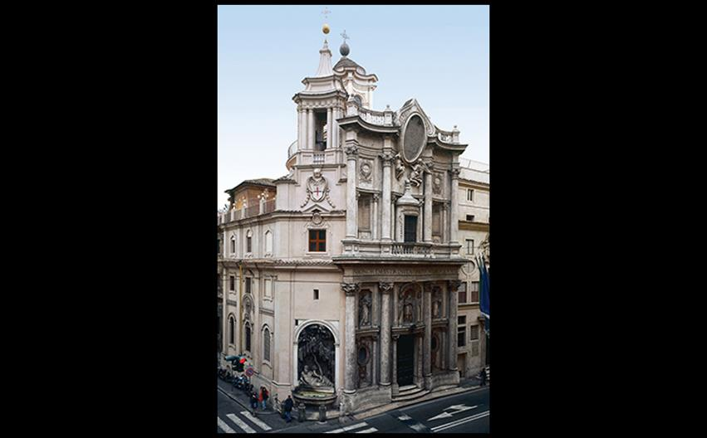
Francesco Borromini FAÇADE OF THE CHURCH OF SAN CARLO ALLE QUATTRO FONTANE Rome. 1638–1667. © 2016. Photo Scala, Florence.
Notes:
Francesco Borromini FAÇADE OF THE CHURCH OF SAN CARLO ALLE QUATTRO FONTANE Rome. 1638–1667. © 2016. Photo Scala, Florence.

Slide 20
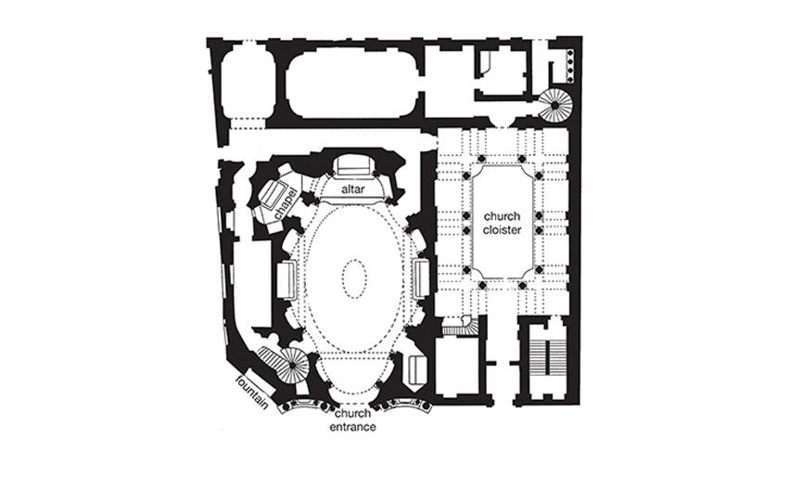
Francesco Borromini PLAN OF THE CHURCH OF SAN CARLO ALLE QUATTRO FONTANE Rome. 1638–1667.
Notes:
Francesco Borromini PLAN OF THE CHURCH OF SAN CARLO ALLE QUATTRO FONTANE Rome. 1638–1667.

Slide 21
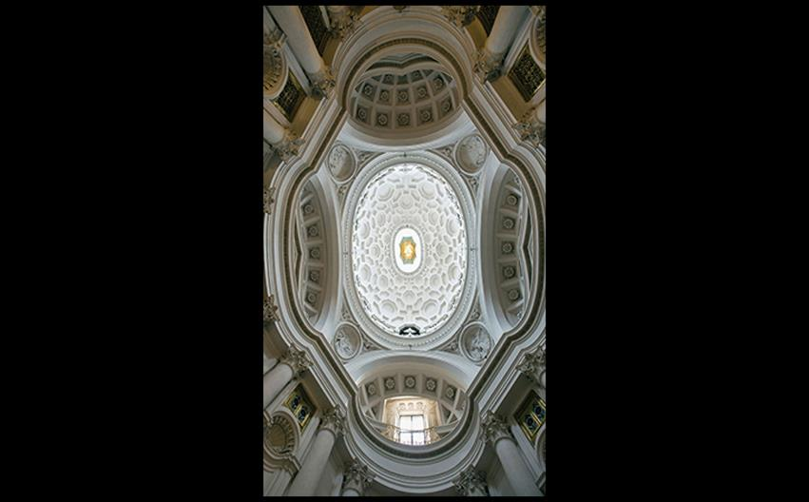
Francesco Borromini VIEW INTO THE DOME OF THE CHURCH OF SAN CARLO ALLE QUATTRO FONTANE Rome. 1638–1667. © View Pictures Ltd/Alamy Stock Photo.
Notes:
Francesco Borromini VIEW INTO THE DOME OF THE CHURCH OF SAN CARLO ALLE QUATTRO FONTANE Rome. 1638–1667. © View Pictures Ltd/Alamy Stock Photo.

Slide 22
Painting (1 of 9)
The ordered Classicism of the Caracci rejected the artifice of the Mannerist style and focused on line, compositional structure, and figural solidity.
The dramatic naturalism of Caravaggio, in contrast, developed powerful realism with subjects as gritty as the lowlife of Rome.

Slide 23
Painting (2 of 9)
The Carracci
Brothers Agostino and Annibale with their cousin Ludovico re-evaluated High Renaissance masters.
Annibale was hired to decorate principal rooms in Cardinal Odoardo Farnese's palace.
Complex figural scenes are based on Ovid's Metamorphoses.

Slide 24
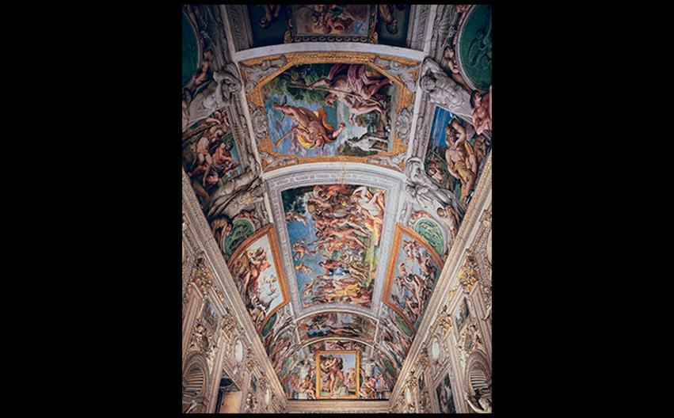
Annibale Carracci CEILING OF GALLERY, PALAZZO FARNESE Rome. 1597–1601. Fresco, approx. 68' × 21' (20.7 × 6.4 m). Canali Photobank, Milan, Italy.
Notes:
Annibale Carracci CEILING OF GALLERY, PALAZZO FARNESE Rome. 1597–1601. Fresco, approx. 68' × 21' (20.7 × 6.4 m). Canali Photobank, Milan, Italy.

Slide 25
Painting (3 of 9)
Caravaggio
The subjects of Caravaggio (1571–1610) in the 1590s include still lifes and scenes of young men dressed as mythological figures.
Bacchus may represent an erotic invitation or an actor in the role of the god of wine, an ambiguity made more striking by the juxtaposition with rotting fruit.

Slide 26
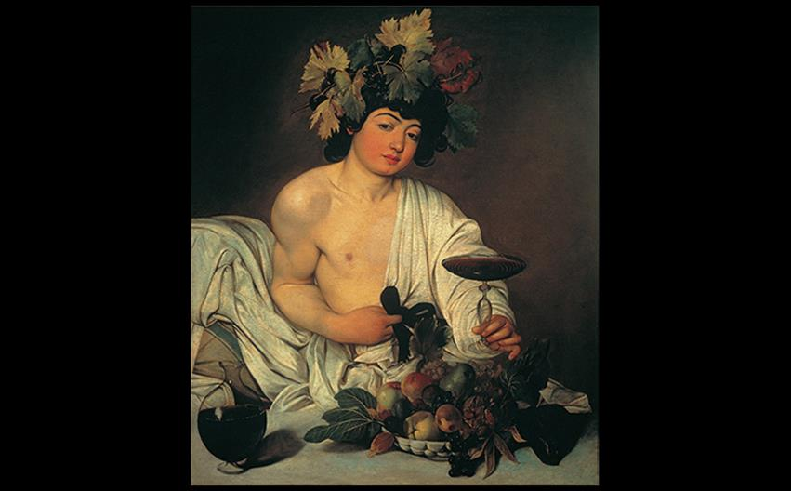
Caravaggio BACCHUS 1595–1596. Oil on canvas, 37 × 33-1/2" (94 × 85.1 cm). Galleria degli Uffizi, Florence. © Quattrone, Florence.
Notes:
Caravaggio BACCHUS 1595–1596. Oil on canvas, 37 × 33-1/2" (94 × 85.1 cm). Galleria degli Uffizi, Florence. © Quattrone, Florence.

Slide 27
Painting (4 of 9)
Caravaggio
The technique created by Caravaggio known as tenebrism involved figures emerging from a dark background into a strong light that falls from a single source, like a theatrical spotlight.

Slide 28
Painting (5 of 9)
Caravaggio
Caravaggio's commissions after 1600 were for religious art.
In the Contarelli Chapel, three large oil paintings on the subject of St. Matthew were produced in a studio instead of directly applied to the wall in fresco.
The Calling of St. Matthew features particularly stark contrast between the dark interior and the spotlight on the surprised saint.

Slide 29
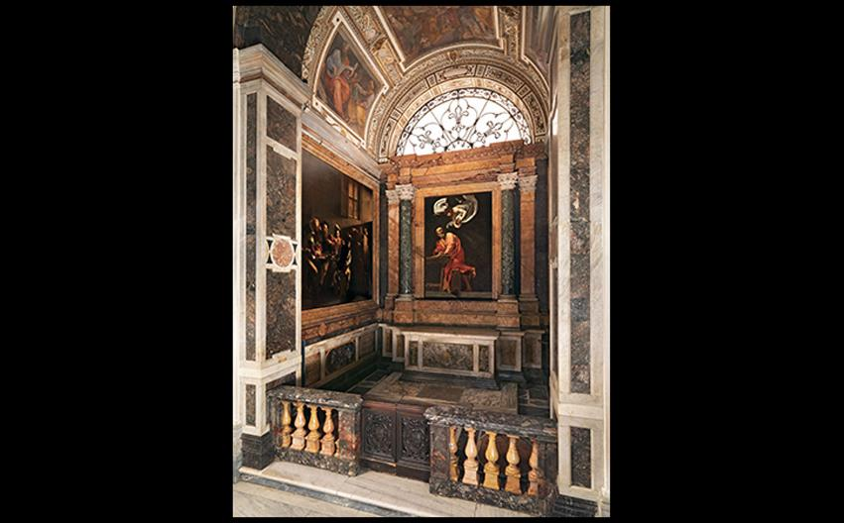
CONTARELLI CHAPEL, SAN LUIGI DEI FRANCESI Rome. Paintings by Caravaggio 1599–1600. © 2016. Photo Scala, Florence.
Notes:
CONTARELLI CHAPEL, SAN LUIGI DEI FRANCESI Rome. Paintings by Caravaggio 1599–1600. © 2016. Photo Scala, Florence.

Slide 30
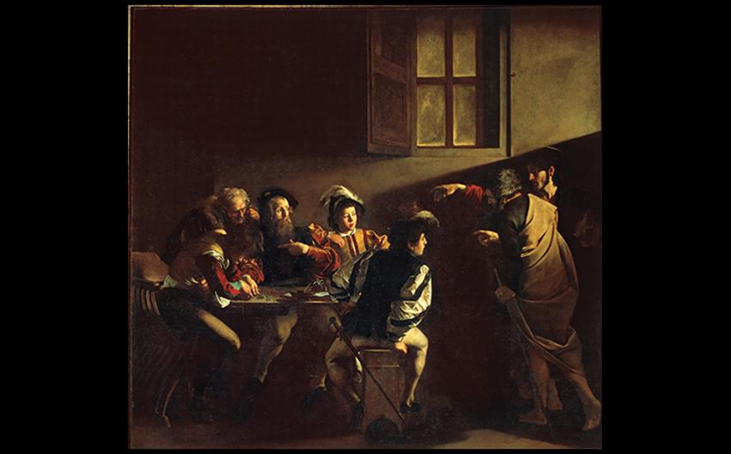
Caravaggio THE CALLING OF ST. MATTHEW Contarelli Chapel, church of San Luigi dei Francesi, Rome. 1599–1600. Oil on canvas, 10'7-1/2" × 11'2" (3.24 × 3.4 m). © Quattrone, Florence.
Notes:
Caravaggio THE CALLING OF ST. MATTHEW Contarelli Chapel, church of San Luigi dei Francesi, Rome. 1599–1600. Oil on canvas, 10'7-1/2" × 11'2" (3.24 × 3.4 m). © Quattrone, Florence.

Slide 31
Painting (6 of 9)
Caravaggio
The Conversion of St. Paul is a painting with no physical setting that focuses on Paul's internal movement.
The horse takes up more space than the saint, causing more tension.
The artist's temper got him into trouble, eventually leading to his killing a man over a disputed tennis match.

Slide 32
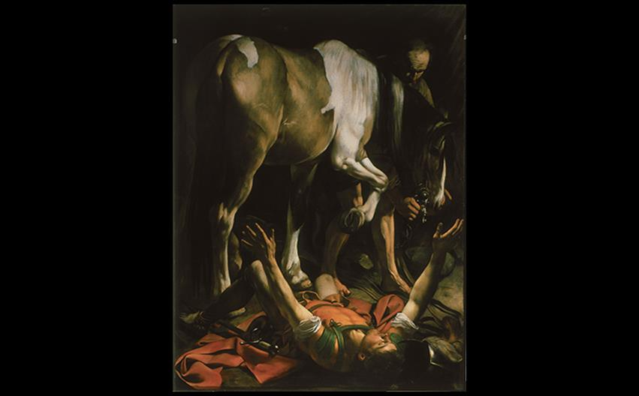
Caravaggio THE CONVERSION OF ST. PAUL Cerasi Chapel, Santa Maria del Popolo, Rome. c. 1601. Oil on canvas, 7'6" × 5'8" (2.3 × 1.75 m). © Vincenzo Pirozzi, Rome.
Notes:
Caravaggio THE CONVERSION OF ST. PAUL Cerasi Chapel, Santa Maria del Popolo, Rome. c. 1601. Oil on canvas, 7'6" × 5'8" (2.3 × 1.75 m). © Vincenzo Pirozzi, Rome.

Slide 33
Painting (7 of 9)
Artemisia Gentileschi
She helped spread the Caravaggesque style beyond Rome, first studying under her father.
Judith Beheading Holofernes draws its subject from the book of Judith.
The heroic act is emphasized by gory details such as blood spurting wildly from the victim's neck.

Slide 34
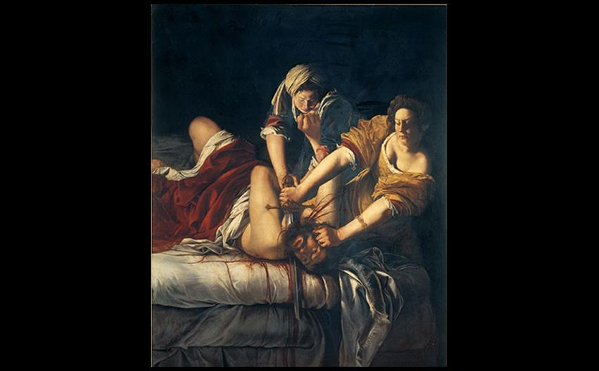
Artemisia Gentileschi JUDITH BEHEADING HOLOFERNES c. 1619–20. Oil on canvas, 6'6-3/8" × 5'4" (1.99 × 1.63 m). Galleria degli Uffizi, Florence. © Quattrone, Florence - courtesy of the Ministero Beni e Att. Culturali.
Notes:
Artemisia Gentileschi JUDITH BEHEADING HOLOFERNES c. 1619–20. Oil on canvas, 6'6-3/8" × 5'4" (1.99 × 1.63 m). Galleria degli Uffizi, Florence. © Quattrone, Florence - courtesy of the Ministero Beni e Att. Culturali.

Slide 35
Painting (8 of 9)
Cortona and Gaulli: Baroque Ceilings
Painters sought to portray an immeasurable heaven through using the viewpoint called di sotto in sù.
Pietro da Cortona's The Glorification of the Papacy of Urban VIII was structured around framing and mythological scenes.
The subject is an allegory of the virtues of the pope.

Slide 36
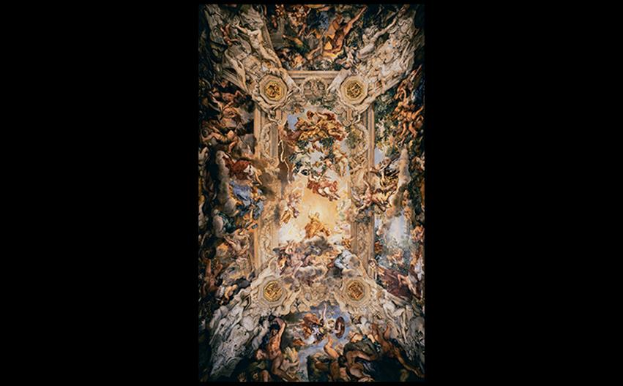
Pietro da Cortona THE GLORIFICATION OF THE PAPACY OF URBAN VIII Ceiling in the Gran Salone, Palazzo Barberini, Rome. 1632–1639. Fresco. Palazzo Barberini, Italy/Canali Photobank, Milan, Italy.
Notes:
Pietro da Cortona THE GLORIFICATION OF THE PAPACY OF URBAN VIII Ceiling in the Gran Salone, Palazzo Barberini, Rome. 1632–1639. Fresco. Palazzo Barberini, Italy/Canali Photobank, Milan, Italy.

Slide 37
Painting (9 of 9)
Cortona and Gaulli: Baroque Ceilings
Giovanni Battista Gaulli's The Triumph of the Name of Jesus and the Fall of the Damned fused sculpture and painting to eliminate any appearance of architectural division.
Every element builds the illusion that clouds and angels have descended into the top of the church during the Last Judgment.

Slide 38
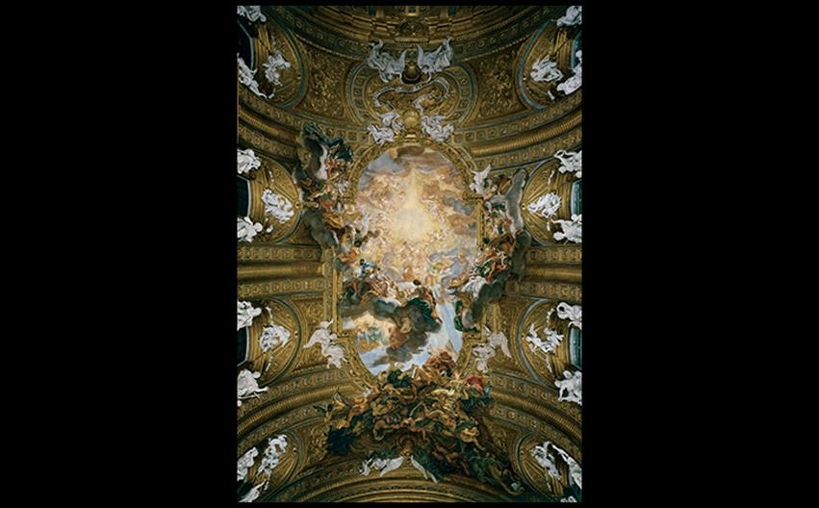
Giovanni Battista Gaulli THE TRIUMPH OF THE NAME OF JESUS AND FALL OF THE DAMNED Vault of the church of Il Gesù, Rome. 1672–1685. Fresco with stucco figures. © Vincenzo Pirozzi, Rome.
Notes:
Giovanni Battista Gaulli THE TRIUMPH OF THE NAME OF JESUS AND FALL OF THE DAMNED Vault of the church of Il Gesù, Rome. 1672–1685. Fresco with stucco figures. © Vincenzo Pirozzi, Rome

Slide 39
Spain
Spanish Habsburg kings Philip III, Philip IV, and Charles II reigned over a weakening empire.
Naples was in a constant state of unrest and the Netherlands gained independence in 1648.
Writers and artists produced great works despite the suffering of agriculture, industry, and trade.

Slide 40
Painting in Spain's Golden Age (1 of 8)
The primary influence on Spanish painting was Flanders in the fifteenth century, and Florence and Rome in the sixteenth century.
Seventeenth-century painting was influenced by the drama of Caravaggio.

Slide 41
Painting in Spain's Golden Age (2 of 8)
Juan Sánchez Cotán
Still Life with Quince, Cabbage, Melon, and Cucumber contrasts curved shapes of the fruits and vegetables with angular geometry of the cantarero.
He was fascinated with spatial ambiguity and contemplative sensibility.

Slide 42
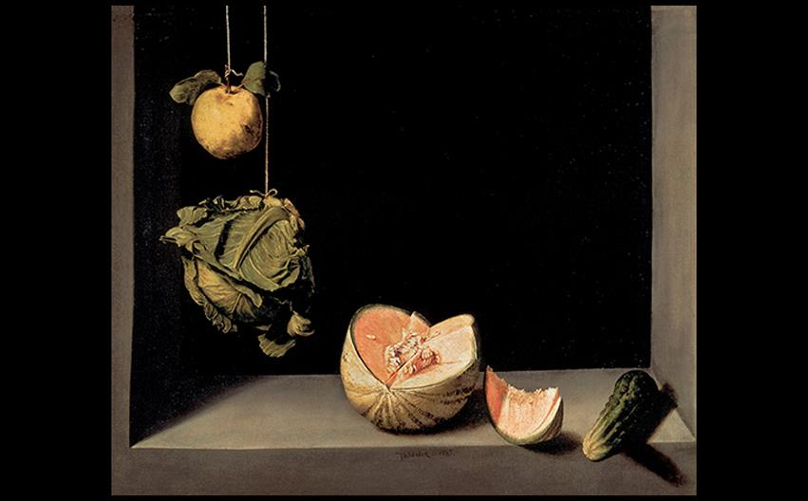
Juan Sánchez Cotán STILL LIFE WITH QUINCE, CABBAGE, MELON, AND CUCUMBER c. 1602. Oil on canvas, 27-1/8" × 33-1/4" (68.8 × 84.4 cm). San Diego Museum of Art. Gift of Anne R. and Amy Putnam. © akg-images/De Agostini Picture Lib.
Notes:
Juan Sánchez Cotán STILL LIFE WITH QUINCE, CABBAGE, MELON, AND CUCUMBER c. 1602. Oil on canvas, 27-1/8" × 33-1/4" (68.8 × 84.4 cm). San Diego Museum of Art. Gift of Anne R. and Amy Putnam. © akg-images/De Agostini Picture Lib. [Fig. 23-16]

Slide 43
Painting in Spain's Golden Age (3 of 8)
Jusepe de Ribera
Nicknamed "Lo Spagnoletto," he combined styles to create a new Neapolitan style.
The Martyrdom of St. Bartholomew captures the horror of the impending violence of being skinned alive.
Compression of figures into the foreground heightens the viewer's sense of witness to the scene.

Slide 44
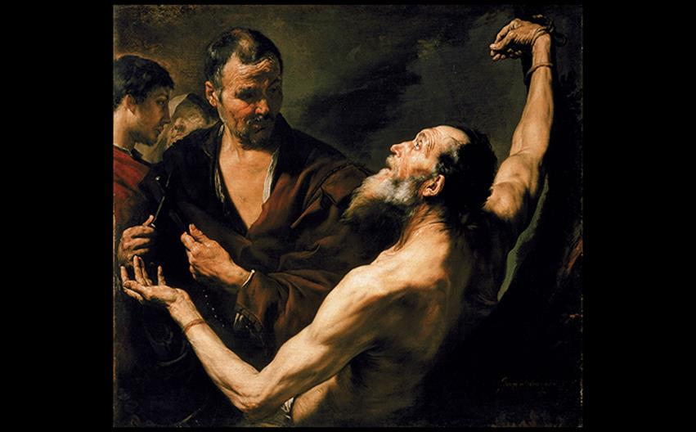
Jusepe de Ribera MARTYRDOM OF ST. BARTHOLOMEW 1634. Oil on canvas, 41-1/4" × 44-7/8" (1.05 × 1.14 m). National Gallery of Art, Washington, DC. Rosenwald Collection (1950.14.744). Image courtesy the National Gallery of Art, Washington.
Notes:
Jusepe de Ribera MARTYRDOM OF ST. BARTHOLOMEW 1634. Oil on canvas, 41-1/4" × 44-7/8" (1.05 × 1.14 m). National Gallery of Art, Washington, DC. Rosenwald Collection (1950.14.744). Image courtesy the National Gallery of Art, Washington.

Slide 45
Painting in Spain's Golden Age (4 of 8)
Francisco de Zurbarán
This artist emerged from the same Caravaggesque school of Seville as Velásquez.
St. Serapion is an arresting portrayal of a dead saint who sacrificed himself for the rescue of Christian captives.
The only colors are the red and gold of the insignia, making the portrait a tragic still life study of fabric and flesh.

Slide 46
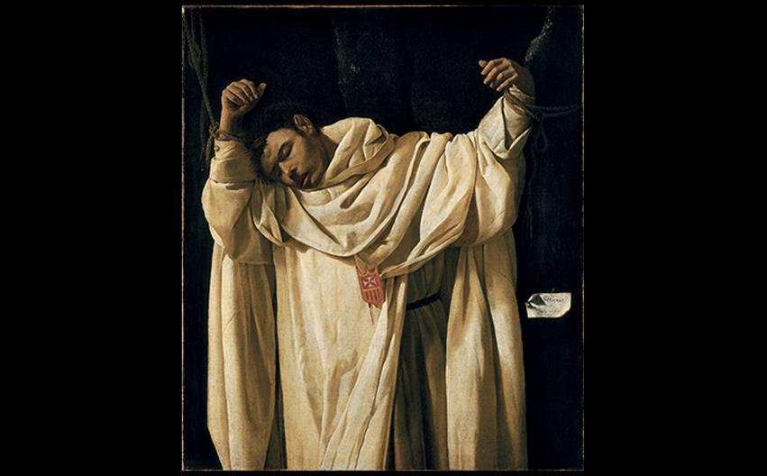
Francisco de Zurbarán ST. SERAPION 1628. Oil on canvas, 47-1/2 × 40-3/4" (120.7 × 103.5 cm). Wadsworth Atheneum, Hartford, Connecticut. Ella Gallup Sumner and Mary Catlin Sumner Collection Fund. Wadsworth Atheneum, Photo: Allen Phillips.
Notes:
Francisco de Zurbarán ST. SERAPION 1628. Oil on canvas, 47-1/2 × 40-3/4" (120.7 × 103.5 cm). Wadsworth Atheneum, Hartford, Connecticut. Ella Gallup Sumner and Mary Catlin Sumner Collection Fund. Wadsworth Atheneum, Photo: Allen Phillips.

Slide 47
Painting in Spain's Golden Age (5 of 8)
Velázquez and Murillo
Diego Velázquez was one of the most brilliant painters of the age.
The model for Water Carrier of Seville was a well-known character in the city, symbolizing Velázquez's working from life and ordinary people.
He became official court painter to Philip IV until his death in 1660.

Slide 48
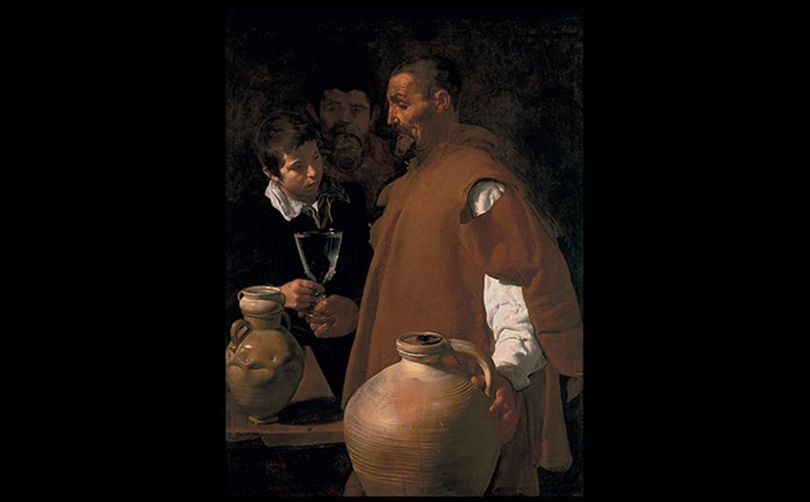
Diego Velázquez WATER CARRIER OF SEVILLE c. 1619. Oil on canvas, 41-1/2" × 31-1/2" (105.3 × 80 cm). Victoria & Albert Museum, London. V&A Images/Victoria and Albert Museum.
Notes:
Diego Velázquez WATER CARRIER OF SEVILLE c. 1619. Oil on canvas, 41-1/2" × 31-1/2" (105.3 × 80 cm). Victoria & Albert Museum, London. V&A Images/Victoria and Albert Museum.

Slide 49
Painting in Spain's Golden Age (6 of 8)
Velázquez and Murillo
The Surrender at Breda was borne of Velázquez's studies in Italy.
The theme of triumph and conquest is removed from military propaganda.
The exchange seems gracious, resembling a courtly ideal.
Compositional virtuosity comes to the fore with controlled color and texture.

Slide 50
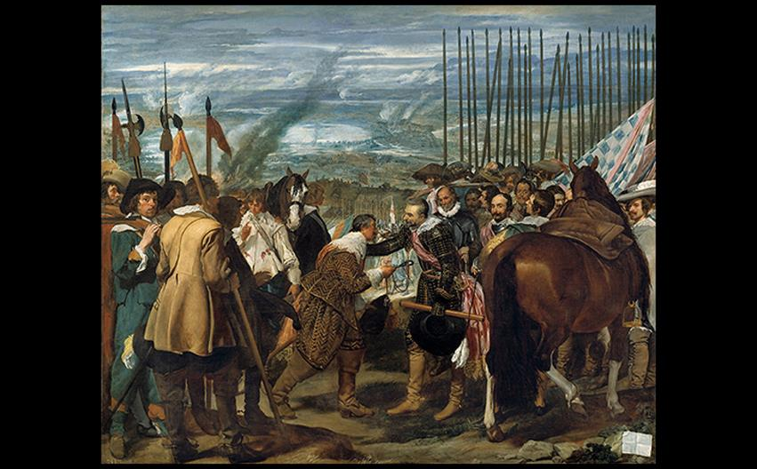
Diego Velázquez THE SURRENDER AT BREDA (THE LANCES) 1634–1635. Oil on canvas, 10'-7/8" × 12’-1/2" (3.07 × 3.67 m). Museo del Prado, Madrid. © 2016. Image Copyright Museo Nacional del Prado. © Photo MNP/Scala, Florence.
Notes:
Diego Velázquez THE SURRENDER AT BREDA (THE LANCES) 1634–1635. Oil on canvas, 10'-7/8" × 12’-1/2" (3.07 × 3.67 m). Museo del Prado, Madrid. © 2016. Image Copyright Museo Nacional del Prado. © Photo MNP/Scala, Florence.

Slide 51
Painting in Spain's Golden Age (7 of 8)
Velázquez and Murillo
Las Meninas is an enormous multiple portrait featuring the king, queen, Infanta Margarita, maids of honor, and even the painter himself.
No consensus exists on the precise meaning of this painting other than royal portraiture; fundamentally, it is a personal artistic statement.

Slide 52
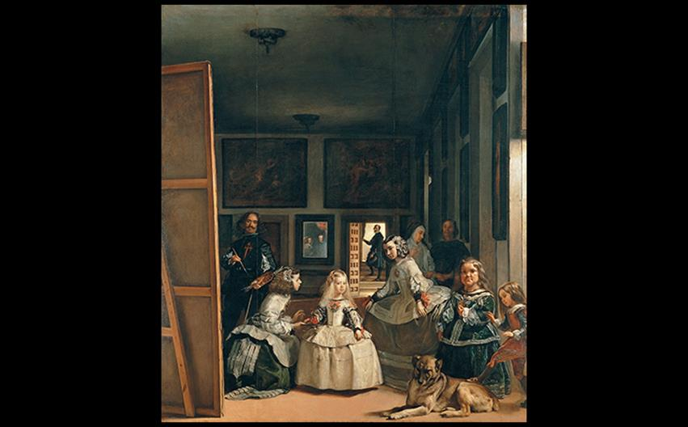
Diego Velázquez LAS MENINAS (THE MAIDS OF HONOR) 1656. Oil on canvas, 10'5" × 9’-1/2" (3.18 × 2.76 m). Museo del Prado, Madrid. © 2016. Photo Scala, Florence.
Notes:
Diego Velázquez LAS MENINAS (THE MAIDS OF HONOR) 1656. Oil on canvas, 10'5" × 9’-1/2" (3.18 × 2.76 m). Museo del Prado, Madrid. © 2016. Photo Scala, Florence

Slide 53
Painting in Spain's Golden Age (8 of 8)
Velázquez and Murillo
Seville declined after an outbreak of the plague in 1649, but art was still influenced by the work of Bartolomé Estebán Murillo, who focused on religious iconography.
The Immaculate Conception shows Mary dressed in blue and white according to Counter-Reformation instructions.

Slide 54
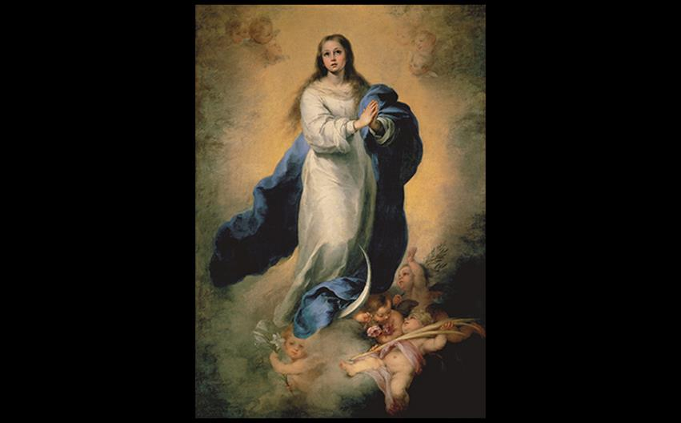
Bartolomé Esteban Murillo THE IMMACULATE CONCEPTION c. 1660–1665. Oil on canvas, 81-1/8" × 56-5/8" (2.06 × 1.44 m). Museo del Prado, Madrid. © 2016. Image Copyright Museo Nacional del Prado. © Photo MNP/Scala, Florence.
Notes:
Bartolomé Esteban Murillo THE IMMACULATE CONCEPTION c. 1660–1665. Oil on canvas, 81-1/8" × 56-5/8" (2.06 × 1.44 m). Museo del Prado, Madrid. © 2016. Image Copyright Museo Nacional del Prado. © Photo MNP/Scala, Florence.

Slide 55
Architecture (1 of 2)
Lavish decoration was once again embraced, opposing the sixteenth-century style of El Escorial.
Ornamentation began to flood back into retablos, then portals, then finally entire buildings.

Slide 56
Architecture (2 of 2)
The Cathedral of Santiago de Compostela
Popular saints challenged the role of St. James as patron saint of Spain.
Renewed interest in pilgrimages called for an elaborate façade to be added to the front of the Cathedral of St. James.
Its redesign focused on a wall of class nicknamed "The Mirror."

Slide 57
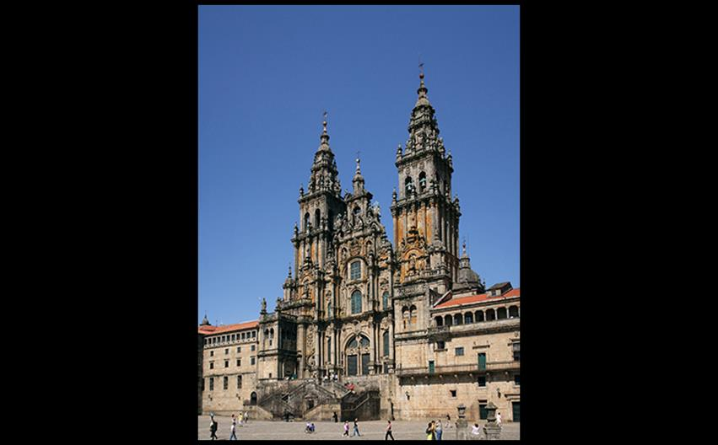
WEST FAÇADE, CATHEDRAL OF ST. JAMES, SANTIAGO DE COMPOSTELA, SPAIN South tower 1667–1680; north tower and central block finished mid 18th century by Fernando de Casas y Nóvoas. © Bartosz Turek/Shutterstock.
Notes:
WEST FAÇADE, CATHEDRAL OF ST. JAMES, SANTIAGO DE COMPOSTELA, SPAIN South tower 1667–1680; north tower and central block finished mid 18th century by Fernando de Casas y Nóvoas. © Bartosz Turek/Shutterstock. [Fig. 23-23]

